Slide 1

C Programming Introduction
Week 4:Variables, constant, Standard input
Lecturers : Cao Tuan Dung
Dept of Software Engineering
Hanoi University of Technology
For HEDSPI Project

Slide 2
Topic of this week
Variables
  Class Lecture Review
    Variables
    Basic data types
    Constants
    Standard input.
  Programming Exercises

Slide 3
Identifiers
Names of things (variables, functions, etc.)
  int nMyPresentIncome = 0;
  int DownloadOrBuyCD();

Slide 4
Identifier naming rules
Letters, digits, underscores
  i
  CSE_5a
  a_very_long_name_that_isnt_very_useful
  fahrenheit
First character cannot be a digit
  5a_CSE is not valid!
Case sensitive
  CSE_5a is different from cse_5a

Slide 5
What are variables?
A named area in the computer memory, intended to contain values of a certain kind (integers, real numbers, etc.)
They contain the data your program works with
They can be used to store data to be used elsewhere in the program
In short – they are the only way to manipulate data

Slide 6
Variables
Named region of storage
  int nRow = 0;
Type (size and meaning of the storage)
Scope
  Block
  Function args
  Global
  Be careful not to “hide” a variable
Lifetime (storage class)
  Automatic/temporary (block's lifetime)
  Globals (program's lifetime)
  Local static (program's lifetime)

Slide 7
Variables in memory
int my_int = 5;
double my_double = 3.5;
my_int
5
my_double
3.5

Slide 8
Declarations, definitions, initialization
Declarations that reserve storage are called definitions
  int j;
Definitions may optionally assign a value (initialization)
  int j = 0;
Declarations specify meaning but may not reserve storage (e.g. extern)
  extern int j;
Release builds typically don't initialize
variables by default!
Usage variables:
e.g: printf(“%d + %d = %d\n“, a, b, c);

Slide 9
Example: variable declarations
int i;
char c;
float f1, f2;
float f1=7.0, f2 = 5.2;
unsigned int ui = 0;

Slide 10
Example
12
c
#include <stdio.h>
int main()
{
int a, b, c;
printf(“The first number: “);
scanf(“%d”, &a);
printf(“The second number: “);
scanf(“%d”, &b);
c = a + b;
printf(“%d + %d = %d\n“, a, b, c);
return 0;
}
7
b
5
a
/ngonnguC/bin/tong
The first number:
5
The second number:
7
5 + 7 = 12
/ngonnguC/bin/

Slide 11
Variables and Constants
Variables:
  Name for a memory object.
  Used to store values and we can change these values.
  Declaration: Tells compiler about variables and their type <typename> varname;
  e.g:
  int i;
  float x, y, z;
  char c;
  Assignment: <varname> = <value>;
  vd:
  i = 4;
  x = 5.4;
  y = z = 1.2;

Slide 12
Variables and Constants (2)
Constant: the value is invariable during the program.
  Declaration constant:
  #define <constantname> <value>
  example:
  #define TRUE 1
  #define FALSE 0

Slide 13
Constants (1)
Integer constants
  31 /* decimal */
  037 /* octal */
  0x1F /* hexadecimal */
  31L /* long */
  31LU /* unsigned long */
Float constants
  123.4 /* double */
  123.4F /* float */
  123. /* double */
  123.F /* float */
  123.4L /* long double */
  1e-2 /* double */
  123.4e-3 /* double */

Slide 14
Constants (2)
Character constants
  'K' /* normal ASCII – 'K' */
  '\113' /* octal ASCII – 'K' */
  '\x48' /* hexadecimal ASCII – 'K' */
  '\n' /* normal ASCII – newline */
  '\t' /* normal ASCII – tab */
  '\\' /* normal ASCII – backslash */
  '\"' /* normal ASCII – double quote */
  '\0' /* normal ASCII – null (marks end of string)*/
String literals
  "You have fifteen thousand new messages."
  "I said, \"Crack, we're under attack!\"."
  "hello," "world" becomes→ "hello, world"

Slide 15
Basic data types (1)
Sizes and limits (may vary for machine; CUNIX is shown here):
float has 6 bits of precision (on CUNIX)
double has 15 bits of precision (on CUNIX)
range differs from one machine to another
  int is “native” size
type | size in bits (on CUNIX) | range
char | 8 | -128...127
short | 16 | -32,768…32,767
int | 32 | -2,147,483,648…2,147,483,647
long | 32 | -2,147,483,648…2,147,483,647
float | 32 | 10⁻³⁸…3x10³⁸
double | 64 | 2x10⁻³⁰⁸…10³⁰⁸

Slide 16
Basic data types (2)
You can also have unsigned values:
Look at /usr/include/limits.h
type | size in bits (on CUNIX) | range
unsigned char | 8 | 0...255
unsigned short | 16 | 0…65,535
unsigned int | 32 | 0…4,294,967,295
unsigned long | 32 | 0…4,294,967,295

Slide 17
Formatting Input with Scanf
scanf
  Input formatting
  Capabilities
    Input all types of data
    Input specific characters
    Skip specific characters
Format
  scanf(format-control-string, other-arguments);
  format-control-string - describes formats of inputs
  other-arguments - pointers to variables where input will be stored
  can include field widths to read a specific number of characters from the stream

Slide 18
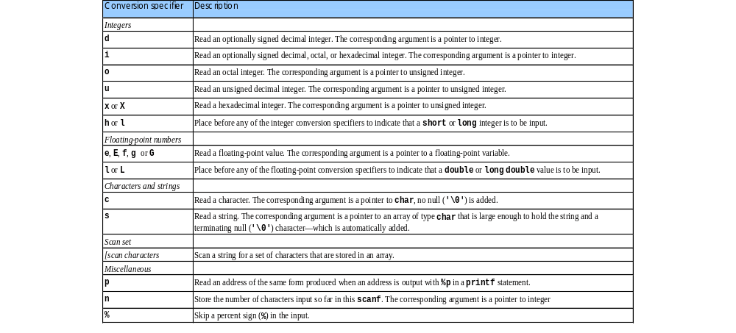
Formatting Input with Scanf (II)

Slide 19
Example of scanf()
int d,m,y,x;
char ch1,ch2;
float f;
scanf(“%d”, &x); 4
// x=4
scanf(“%2d%2d%4d”, &d,&m,&y); 22062007
// d=22, m=6, y=2007
scanf(“%d/%d/%d”, &d,&m,&y); 22/06/2007
// d=22, m=6, y=2007
scanf(“%c%c”, &ch1,&ch2); Ab
// ch1=‘A’, ch2=‘b’
scanf(“%f”, &f); 2.3
// f=2.300000
Result

Slide 20
Formatting Input with Scanf (III)
Scan sets
  Set of characters enclosed in square brackets []
    Preceded by % sign
  Scans input stream, looking only for characters in scan set
    Whenever a match occurs, stores character in specified array
    Stops scanning once a mismatch is found
  Inverted scan sets
    Use a caret ^: [^aeiou]
    Causes characters not in the scan set to be stored

Slide 21
Formatting Input with Scanf (IV)
Skipping characters
  Include character to skip in format control
  Or, use * (assignment suppression character)
    Skips any type of character without storing it

Slide 22
Example 2
Reading characters and strings
1 #include <stdio.h>
2
3 int main()
4 {
5 char x, y[ 9 ];
6
7 printf( "Enter a string: " );
8 scanf( "%c%s", &x, y );
9
10 printf( "The input was:\n" );
11 printf( "the character \"%c\" ", x );
12 printf( "and the string \"%s\"\n", y );
13
14 return 0;
15 }
Enter a string: Sunday
The input was:
the character "S" and the string "unday"

Slide 23
Example 3
Using an inverted scan set
2 #include <stdio.h>
3
4 int main()
5 {
6 char z[ 9 ] = { '\0' };
7
8 printf( "Enter a string: " );
9 scanf( "%[^aeiou]", z );
10 printf( "The input was \"%s\"\n", z );
11
12 return 0;
13 }
Enter a string: String
The input was "Str"

Slide 24
Example 4
Reading and discarding characters from the input stream
1 #include <stdio.h>
2
3 int main()
4 {
5 int month1, day1, year1, month2, day2, year2;
6
7 printf( "Enter a date in the form mm-dd-yyyy: " );
8 scanf( "%d%*c%d%*c%d", &month1, &day1, &year1 );
9 printf( "month = %d day = %d year = %d\n\n",
10 month1, day1, year1 );
10 printf( "Enter a date in the form mm/dd/yyyy: " );
14 scanf( "%d%*c%d%*c%d", &month2, &day2, &year2 );
15 printf( "month = %d day = %d year = %d\n",
16 month2, day2, year2 );
17
18 return 0;
19 }
Enter a date in the form mm-dd-yyyy: 11-18-2000
month = 11 day = 18 year = 2000
Enter a date in the form mm/dd/yyyy: 11/18/2000
month = 11 day = 18 year = 2000

Slide 25
Exercises 4.1
Write a program that reads a integer and a double from user, use a floating-point and an integer variable to store and then show to screen.

Slide 26
Solution
#include <stdio.h>
void main (void) {
/* We will use a floating-point and an integer variable. */
double x;
int n;
/* Read in an integer. */
printf("Please enter an integer: ");
scanf("%d", &n);
printf("The integer was %d\n\n", n);

Slide 27
Solution
/* Read in a double. */
printf("Please enter a double: ");
scanf("%lf", &x);
printf("The double was %g\n\n", x);
/* Read in an integer and a double. */
printf("Please enter an integer and a floating-point number: ");
scanf("%d%lf", &n, &x);
printf("The numbers were %d %g\n", n, x);
}

Slide 28
Exercises 4.2
Write and run this program to see the limit of basic data types: int, long.
Widen this program for other basic data types.
Use limits.h library to build your programs.

Slide 29
Solution
#include <stdio.h>
#include <limits.h> /* defines INT_MIN, INT_MAX, LONG_MIN, LONG_MAX */
main()
{
int j;
long int k;
float x;
double z;
printf("Enter an integer (between %i and %i): ", INT_MIN, INT_MAX);
scanf("%i", &j);
printf("You entered %d\n\n", j);

Slide 30
Solution
printf("Enter a long integer (between %ld and %ld): ", LONG_MIN, LONG_MAX);
scanf("%ld", &k);
printf("You entered %li\n\n", k);
printf("Enter a floating point number: ");
scanf("%f", &x);
printf("You entered %20.10E\n\n", x);
printf("Enter a double precision floating point number: ");
scanf("%lf", &z);
printf("You entered %20.10E\n\n", z);
puts("\n\nTry again: enter invalid data and see what happens!");
}

Slide 31
Exercises 4.3
Write a program that reads a string from the keyboard by using a scan set.

Slide 32
Solution
#include <stdio.h>
/* function main begins program execution */
int main( void )
{
char z[ 9 ];
printf( "Enter string: " );
scanf( "%[aeiou]", z ); /* search for set of characters */
printf( "The input was \"%s\"\n", z );
return 0;
}

Slide 33
Exercises 4.4
Write a program that inputs data with a field width.
Widen to all basic data types.

Slide 34
Solution
#include <stdio.h>
int main( void )
{
int x;
int y;
printf( "Enter a six digit integer: " );
scanf( "%2d%d", &x, &y );
printf( "The integers input were %d and %d\n", x, y );
return 0; /* indicates successful termination */
}

Slide 35
Exercise 4.5
Write a program ask user to input the radius of a circle. Use constant for PI.
  a) Display its area and circumference.
  b) Now consider the input data is the radius of a sphere. Display its area and volume.

Slide 36
Solution
#include <stdio.h>
#define PI 3.142
main()
{
double r, c, ac, as, v;
r = 5.678;
printf("Radius = %f\n", r);
c = 2.0 * PI * r;
printf("Circle's circumference = %f\n", c);
ac = PI * r * r;
printf("Circle's area = %f\n", ac);
as = 4.0 * PI * r * r;
printf("Sphere's area = %f\n", as);
v = 4.0/3.0 * PI * r * r * r;
printf("Sphere's volume = %f\n", v);
}

Slide 37
Exercise 4.6
Write a program that calculates and displays an employee’s total wages for week. The regular hours for the work week are 40 and any hours worked over 40 are considered overtime. The employee earns 25000 VND per hour for regular hours, and 40000 VND per hour for overtime hours. This week employee has worked 50 hours.

Slide 38
Solution
#include <stdio.h>
int main()
{
double regWages, // calculated regular wages
basePay = 25000, // base pay rate
regHours = 40.0, // hours worked less overtime
otWages, // overtime wages
otPay = 40000, // overtime pay rate
otHours = 10, // overtime hours worked
totalWages; // total wages
regWages = basePay * regHours;
otWages = otPay * otHours;
totalWages = regWages + otWages;
printf(“\n Wages for this week are %0.1f $“, totalWages);
return 0;
}

Slide 39
Exercise 4.7
Write a program that ask users for information concerning a book you buy at the shop such as: ISBN, Title, Price, Quantity. The VAT is 4%. Program should display these information as the following interface:
BK Bookseller
Qty ISBN Title Price Total
VAT
You pay:

Slide 40
Solution
#include <stdio.h>
int main()
{
double regWages, // calculated regular wages
basePay = 25000, // base pay rate
regHours = 40.0, // hours worked less overtime
otWages, // overtime wages
otPay = 40000, // overtime pay rate
otHours = 10, // overtime hours worked
totalWages; // total wages
regWages = basePay * regHours;
otWages = otPay * otHours;
totalWages = regWages + otWages;
printf(“\n Wages for this week are %0.1f $“, totalWages);
return 0;
}

